Slide 1
Can we get Wi-Fi connectivity for 15 µW?
Bryce Kellogg
Notes:
Can we achieve WiFi connectivity for 15 uW of power.
Hi everyone I'm Bryce and today I’ll talk about how we're going to achieve this goal.

Slide 2
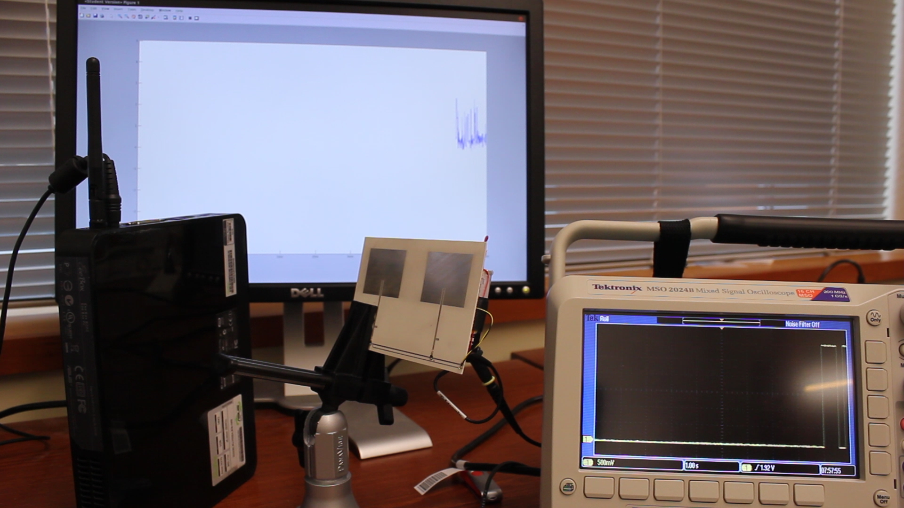
Notes:
But first, I’m going to show you a quick demo video. Here you can see the prototype we built, in the center. It’s going to be transmitting data to this off-the-shelf Intel Wi-Fi device on the left.
You’ll be able to see the transmitted bits on the scope in the lower right hand corner and the received bits on the computer screen in the back.

Slide 3
Prototype consumes 14 µW of power
Notes:
You can see that as we transmit bits from the prototype, the same bits are being received by the off-the-shelf Wi-Fi device.
And the cool thing here is that our prototype consumes only about 14 uW of power.

Slide 4
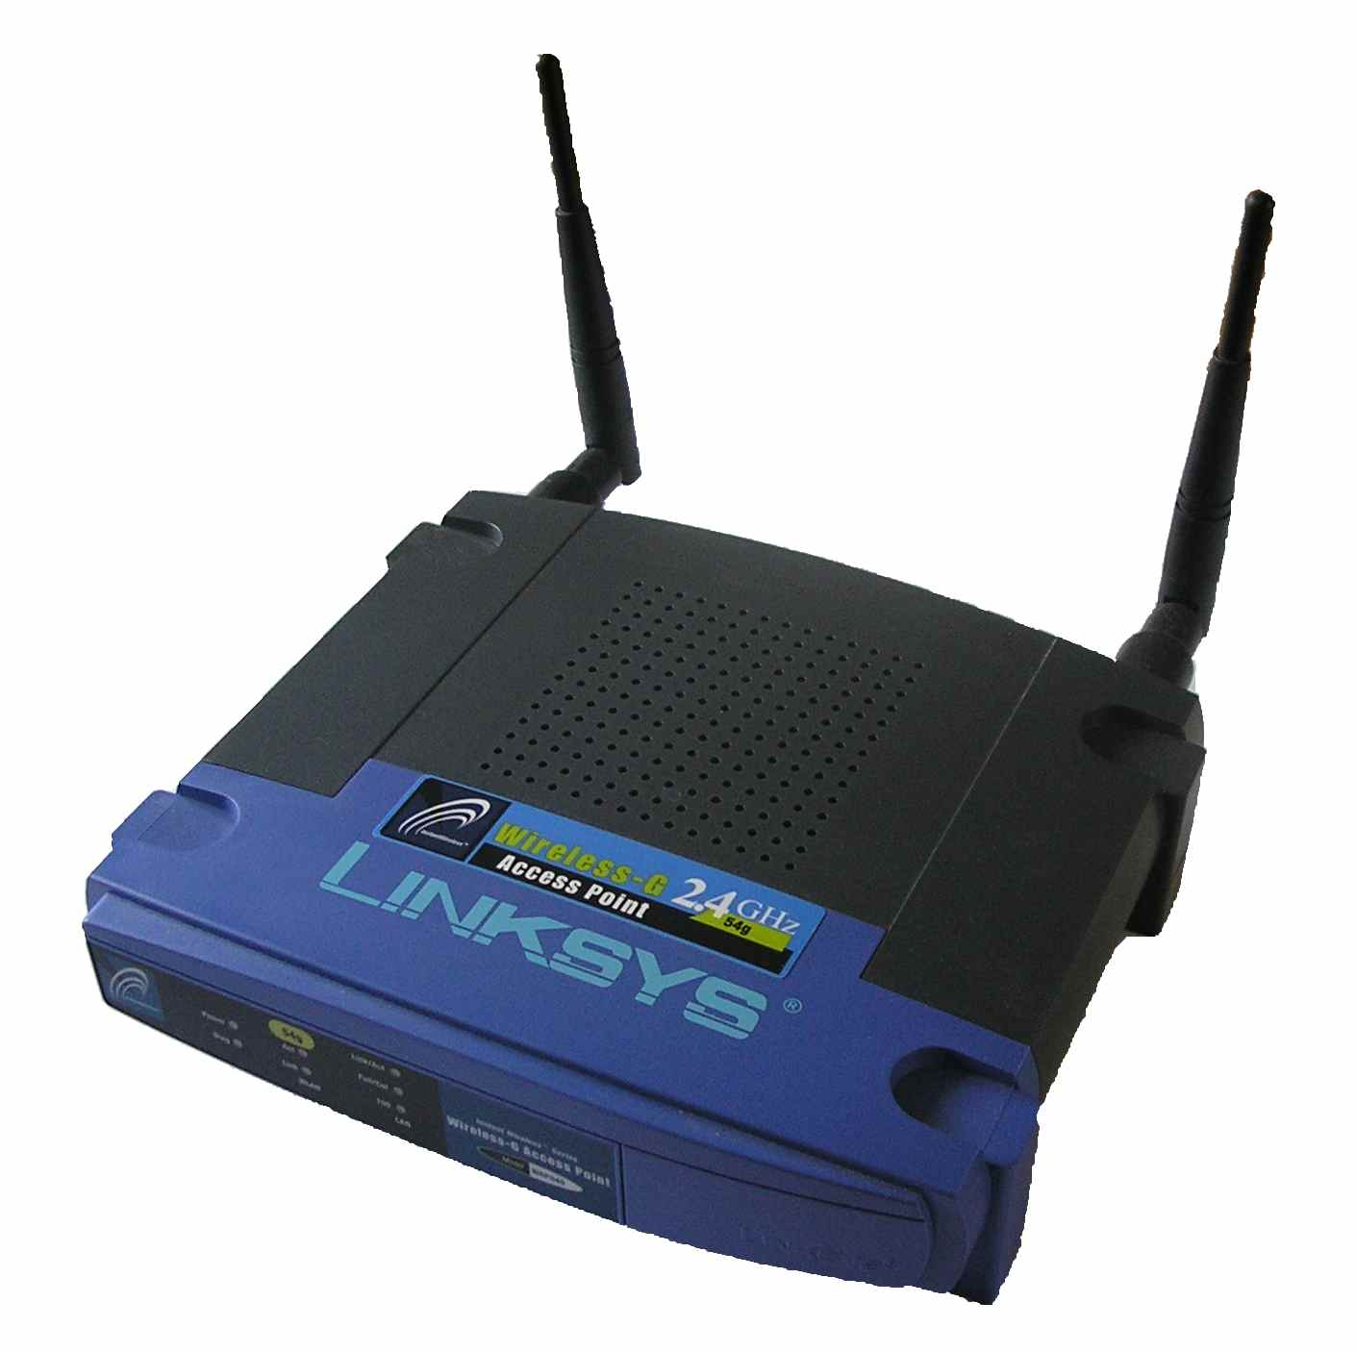
Why is this hard?
Wi-Fi consumes 100 mW of power 10,000x too much
Notes:
To give you a sense of why this is hard, consider the traditional way of connecting to Wi-Fi networks: which is with Wi-Fi.
Wi-Fi is extremely power consuming. A Wi-Fi traditional radio will consume at least 100 mW of power.
That’s 10,000 times too much, so clearly we can’t do this using traditional Wi-Fi.

Slide 5
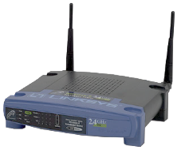
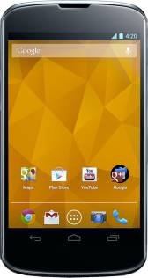
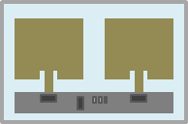
Wi-Fi Backscatter
Key Idea: Piggyback on Wi-Fi Packets
Changing reflections consumes 0.65 µW of power
RSSI
Wi-Fi AP
2
5
6
7
8
4
1
3
9
0
1
Wi-Fi Backscatter Tag
Wi-Fi Device
Notes:
So we introduce something we call Wi-Fi Backscatter.
The key idea is that instead of transmitting Wi-Fi signals, we're going to piggyback information on top of already existing Wi-Fi packets.
Say we have a Wi-Fi enabled device, and a Wi-Fi Backscatter Tag. We want to be able to send data from the Tag to the Wi-Fi Device without the Tag needing to transmit any Wi-Fi packets.
Instead, we’re going to take advantage of an Access Point that is already transmitting packets to our Wi-Fi device.
The way our communication works is the following: we convey information by either reflecting or absorbing these Wi-Fi packets.
Specifically, we are going to convey a one bit by reflecting Wi-Fi packets.
and transmit a zero bit by absorbing the packets.
Now let’s go back a step. When the tag is actually reflecting packets (transmitting a 1), the reflected packet combines with the original packet at the W-Fi device, thus changing the received signal strength or RSSI.
So when you backscatter, you have one signal strength
and when you don‘t, you have another.
The WiFi device can use just this signal strength information to receive data from the Backscatter Tag.
It turns out that reflecting or not reflecting can be done in an extremely low power way by simply modulating the radar cross section of the antenna using a low power RF switch.
This means that changing the reflective properties of the tag consumes less than a uW of power.

Slide 6
How to work in a network of Wi-Fi devices?
How does the Wi-Fi device send data to the tag?
How do we design a network with multiple tags?
Notes:
Of course the picture I just showed you is at a very high level, making this a more practical system results in three main questions.
Previously I said there'd be a single access point and device in the network. But we all know that in a real network there are many Wi-Fi devices. So how do we get Wi-Fi Backscatter to work in a network of Wi-Fi Devices?
Second, while I just showed you how we go from Tag -> Wi-Fi device, how do we go the other way? How does the Wi-Fi device send data to the Tab?
And finally, how do we design a network with multiple tags?

Slide 7
How to work in a network of Wi-Fi devices?
How does the Wi-Fi device send data to the tag?
How do we design a network with multiple tags?
Notes:
Lets start with the first question: how do you get Wi-Fi Backscatter to work in a network of Wi-Fi devices?

Slide 8
Challenge: Cannot Decode Packet Headers
???
Wi-Fi Backscatter Tag
Wi-Fi Device
Notes:
The key challenge here is that since the Backscatter Tag can’t decode Wi-Fi Packet headers, it has no way of knowing if it is backscattering
the laptop’s packet,
the Access Point’s packet,
or the iPhone’s packet.
If the Tag tries to backscatter a new bit on every packet, some of those packets aren’t going to make it to our Wi-Fi device and we’ll end up missing bits.
Per packet modulation clearly doesn't work.

Slide 9
Solution: Be Agnostic to Wi-Fi Traffic
Bin backscatter bits into time slots
Time Slot
1
0
0
1
0
Adjust timeslots based on network traffic
t
10:34:12.12748
10:34:12.12757
10:34:12.12770
10:34:12.12773
10:34:12.12775
10:34:12.12777
10:34:12.12779
10:34:12.12786
10:34:12.12657
10:34:12.12789
10:34:12.12663
10:34:12.12678
10:34:12.12698
10:34:12.12719
10:34:12.12734
Use Wi-Fi timestamp to reconstruct bits
Notes:
Our solution is to make the Backscatter Tag agnostic to Wi-Fi traffic on the medium.
Specifically we're going to increase the bit length from one Wi-Fi packet to include multiple packets in each backscatter bit timeslot.
So before, we were trying to send a bit for each of these blue Wi-Fi packets from the AP,
But now all these red packets are potentially confusing the transmitter.
So, what we do is divide the Backscatter transmission into timeslots, and transmit only one bit (either reflect or not) for all packets in an entire timeslot. As long as the router can get at least one packet in each timeslot, at least one packet will get affected by the backscatter.
The Wi-Fi device can then use the packet timestamp to sort each received packet into the correct bit timeslot and can then decode the transmissions from the tag.
And finally, we can adjust the size of the timeslots to ensure correct transmission based on network traffic conditions.

Slide 10
How to work in a network of Wi-Fi devices?
How does the Wi-Fi device send data to the tag?
How do we design a network with multiple tags?
Notes:
Now that we’ve covered the first challenge, let's go on to the second: how does the Wi-Fi device send data to the tag?

Slide 11
Encode data as presence/absence of Wi-Fi Packet
CTS-to-Self
1
0
1
0
0
0
0
1
1
Wi-Fi Backscatter Tag
Wi-Fi Device
Notes:
What we’re going to do is encode data in the presence or absence of a packet
Let's say the device want to transmit 101000011, and so on.
The Wi-Fi device will transmit a packet for a 1, no packet for the zero, a packet, and so on.
Of course, since we are encoding a 0 as silence, other Wi-Fi devices around us will detect the medium as unoccupied and can transmit in the silence spaces, completely messing up our transmission.
To prevent this we leverage a feature of the 802.11 protocol called CTS which can be used to reserve the channel. So before transmitting data, the Wi-Fi devices sends a CTS-to-self packet to reserve the channel. Other Wi-Fi Devices will respect the 802.11 protocol and abstain from transmitting in the silence periods.
The thing I didn't tell you is how the tag is detecting these Wi-Fi Packets.

Slide 12
Low Power Wi-Fi Packet Detection
Leverage structure of Wi-Fi signal
OFDM: High peak-to-avg power ratio
Notes:
The basic Idea is to leverage the structure of the Wi-Fi signal.
Wi-Fi uses OFDM, seen here is the time domain of a simulated Wi-Fi packet showing the structure of the signal. You can see that the OFDM signal spends lots of its time with very low amplitudes and occasionally has one of these vary large peaks. This means that OFDM has a very high peak-to-average power ratio, and we can use this to our advantage.
We leverage this high peak-to-average power structure of the Wi-Fi OFDM signal to design a circuit to efficiently detect Wi-Fi packets.

Slide 13
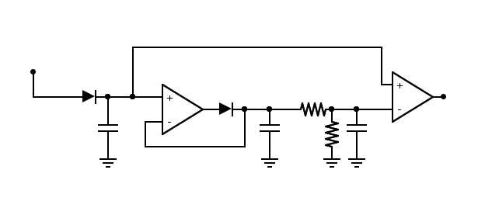
Low Power Wi-Fi Packet Detection
Antenna
Envelope Detector
Comparator
Peak finder
Set threshold
Can detect packets as short as 50 µs
Consumes µWs of power
Notes:
And here is the resulting circuit. It consists of a peak finder circuit, that essentially finds these peaks in OFDM signals, compares them to a threshold, and outputs a binary result: packet or no packet.
This circuit consumes only uWs of power and can detect packets as short as 50 us.

Slide 14
How to work in a network of Wi-Fi devices?
How does the Wi-Fi device send data to the tag?
How do we design a network with multiple tags?
Notes:
Now finally, how do we get Wi-Fi Backscatter to work in a network of Backscatter Tags?

Slide 15
Design Request/Response Protocol
Wi-Fi device act as a central coordinator
CTS
1
1
1
1
1
None of the tags transmit concurrently
0
0
0
CTS
1
0
1
0
1
1
0
1
CTS
1
0
1
0
1
1
0
1
Wi-Fi Device
Notes:
Our solution is to design a request response system where the Wi-Fi device act as a central coordinator and only the Wi-Fi device initiates a data transmission.
Specifically, the Wi-Fi device decides which tags it plans to interrogate, and then queries each tag separately. So it will send a query to the first tag and the first tag will respond. When that data transmission is complete, the Wi-Fi device will move to the next tag: send a query and get a response. Now the next tag: send a query, get a response…and so on until it receives all the data from each device.
Because each data transmission is initiated by the Wi-Fi device, none of the tags transmit concurrently.

Slide 16
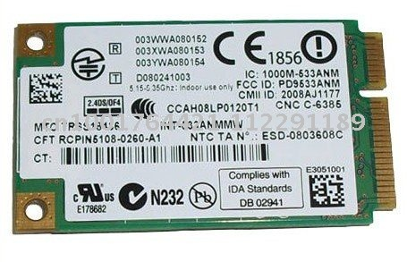
Our Prototype
Intel 5300 Wi-Fi Cards
Wi-Fi Backscatter
Prototype
2.4 GHz Wi-Fi channels
Use both RSSI and CSI values
Notes:
And that’s it! We implemented Wi-Fi Backscatter on Intel 5300 Wi-Fi Cards and built the prototype tag you see here with 6 small patch antennas.
The devices operate on 2.4 GHz Wi-Fi channels, and we use both the common RSSI and the 802.11n and ac CSI measurements of signal strength.

Slide 17
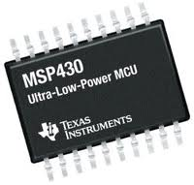
Power Consumption
MSP430: 5.0 µW
RF Switch: 0.65 µW
Peak Finder: 9.0 µW
Total: 14.65 µW
Notes:
I thrown around a lot of power numbers, and here’s how the power consumption of our prototype breaks down.
- The brains of our prototype is an MSP430 microcontroller, that on average consumes around 5 uW of power.
- The RF Switch that controls the TX functionality is extremely low power only consuming a little over half a uW.
- And finally we have the Peak Finder circuit which consumes 9 uW.
These components all add up to give us 14.65 uW power consumption, well within our target of 15 uW.

Slide 18
What is the maximum rate and range?
2.2 meters, 1 kbps
Wi-Fi Backscatter Tag
3.0 meters, 20 kbps
Wi-Fi Device
Notes:
Now we ask how well it works. What is the maximum rate and range we can get?
Transmitting from the tag to the Wi-Fi device we were able to transmit at ranges up to 2.2 meters and we achieved rates up to 1 kbps.
Going the other way, from the Wi-Fi device to the Backscatter Tag, we achieved ranges up to 3 meters and rates up to 20 kbps.
You’ll notice that we get better results going from the Wi-Fi device to the Tag. This is because the CTS-to-Self solution reserve the entire channel for our use and we don’t have to rely on ambient Wi-Fi packets.

Slide 19
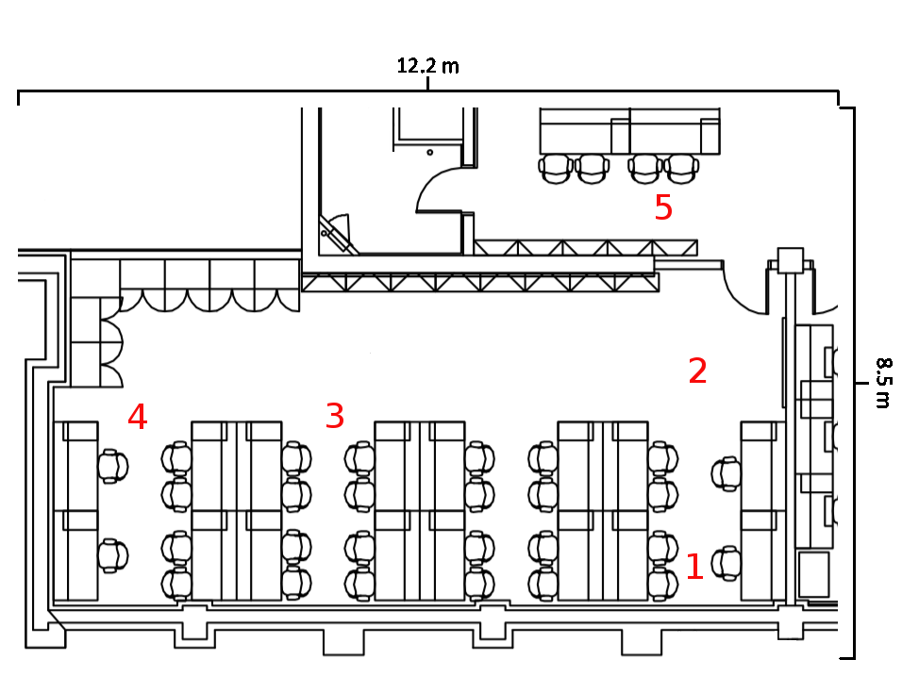
Does AP Location Affect Backscatter Decoding?
12.2 m
Probability of receiving a backscatter packet correctly
3
98%
AP can be far away or even in a different room
99%
94%
3
8.5 m
99%
3
3
3
Notes:
The next question we asked was “Does the location of the AP providing the packets matter?”
To test this, we setup our system in a lab on campus measuring 12.2 m by 8.5 m, floor plan seen here. We fixed the Wi-Fi device and Backscatter Tag at this spot down here on the lower right. We then varied the location of the access point between these other four locations. At each location we calculated the percentage of packets the Wi-Fi device received correctly from the Tag.
Here’s what we saw. To be clear, each of these blue percentages is the probability of the Wi-Fi device correctly receiving a Backscattered packet when the Access Point providing ambient Wi-Fi packets is at each of these locations.
The results range from 94 – 99% indicating that the access point can be far away or even in a different room and independent of the location we still get a high packet delivery probability.

Slide 20
Does Backscatter Affect Wi-Fi Decoding?
12.2 m
3
3
8.5 m
3
3
3
Notes:
Next, we wanted to know how Wi-Fi Backscatter would affect existing WiFi networks, and if it would affect Wi-Fi decoding. To test this, we used a similar setup as before, with the locations of the Wi-Fi device and Backscatter tag fixed and the AP location varied.
For each AP location, the Wi-Fi device initiated a large download from the AP and measured the download rates while we varied the backscatter rate of the tag from 0 bps (not backscattering) to 100 bps.

Slide 21
Does it affect Wi-Fi Performance?
Wi-Fi is robust to multipath environment
Notes:
On the X-axis, we see the four locations for the access point, and on the Y-axis we see the average data rate of the Wi-Fi Device download.
With no backscattering device, we see download speeds around 3 MB/s, as our tag Backscatters at 100 bps we see that there is no significant change in the download rates. This makes sense because Wi-Fi is designed to be robust to changes in the multipath environment such as those introduced by our Wi-Fi Backscatter Tag.

Slide 22
How does it work in a busy network?
Setup in UW Networks Lab: 8 – 15 People
Used University Wi-Fi as AP
Observed maximum achievable bit rate over period of 8 hours
Notes:
Finally, we want to see it in action, see how well it works in a busy Wi-Fi network.
To test this, we setup the Wi-Fi device and Backscatter Tag in a the UW Networks Lab, which is inhabited by somewhere between 8 and 15 people depending on the time of day. As a source of packets we used the University infrastructure Wi-Fi, and observed the maximum achievable Backscatter bit rate over a period of 8 hours.

Slide 23
How does it work in a busy network?
More network traffic → faster Backscatter rates
Notes:
Here are the results: on the x axis we’ve got the time of day ranging from noon to 8 PM.
The left axis shows the network load in number of packets per second.
You can see that this varies throughout the day as people come and go in the lab, with the peak being around 4 PM.
Now the right axis shows the achievable bit rate of the backscatter tag.
In this setup, our bitrates varied between 100 and 200 bps, and fairly closely tracks the number of Wi-Fi packets on the network.
This means that more Wi-Fi traffic results in better Backscatter bit rates.

Slide 24
Related Work
RFID
Requires dedicated reader and new hardware installation
Wi-Fi Backscatter transforms Wi-Fi devices into RFID readers
Ambient Backscatter
Device to device communication
Wi-Fi Backscatter connects devices to existing Wi-Fi networks
Notes:
Finally, Wi-Fi Backscatter is related to existing technologies like RFID, however RFID requires a dedicated reader and installation of new hardware for large scale deployment.
In contrast, Wi-Fi Backscatter essentially transforms existing Wi-Fi devices into RFID readers and enables similar functionality on already deployed ubiquitous hardware.
Wi-Fi Backscatter also builds on previous work our group did on Ambient Backscatter. Ambient Backscatter however is for device to device communication and creates an isolated network.
In contrast, we introduce a way to connect low power devices to existing Wi-Fi networks.

Slide 25
Conclusion
Feasibility of Wi-Fi connectivity at < 15 µW
Can enable RF-Powered Internet of Things, connecting next billion devices
iotWiFi.cs.washington.edu
Notes:
To conclude, with Wi-Fi Backscatter, we showed the feasibility of connecting to existing Wi-Fi networks while only consuming 15 uW of power.
As we continue to do research to increase the range and data rates of these devices, what we’re effectively developing is an extremely powerful primitive that will enable the vision of an RF powered internet of things, where devices can connect directly to the Internet.
With that I’ll conclude my talk and open it up for questions. Thank you.

