Slide 1
Powering the next billion devices with Wi-Fi
Vamsi Talla, Bryce Kellogg, Ben Ransford, Saman Naderiparizi, Shyam Gollakota and Josh Smith
University of Washington
Notes:
Hello my name is Vamsi and today I will talk to you about powering the next billion devices with Wi-Fi. This is a joint work done with my colleagues at the University of Washington

Slide 2
Demo Video
Notes:
To give you a sense of what we are after, I am going to show you a short demo video. Here is a design with an E-Ink display, an accelerometer and micro-controller. (p)
Whenever the user moves his hand, the dot on the E-ink display moves in the direction of the motion. (p) The cool thing here is that the device has no batteries and all these operations are being powered by Wi-Fi router on the other side of the room.

Slide 3
Wi-Fi is a great fit for power delivery
Wi-Fi is ubiquitous in indoor environments
Inexpensive given Wi-Fi’s economies of scale
Negligible size footprint, reuse 2.4 GHz antenna
Notes:
Wi-Fi is a great fit because it is all around us. Be it homes or offices, there is Wi-Fi connectivity at most places.
Second, give the economy of scale of Wi-Fi, Wi-Fi chipsets have become very inexpensive. In fact you can buy a Wi-Fi chip for just a dollar
Finally, most sensors and devices today support Wi-Fi and Bluetooth and hence have 2.4 GHz antennas. In principle we can repurpose these antennas for providing power and have a negligible impact on the size of the device.

Slide 4
Why is this hard?
Wi-Fi is designed for communication and not power delivery
Threshold
Voltage (V)
Time (ms)
Notes:
That’s great but it turns out that this is a hard problem. Wi-Fi has been designed for communication and not power delivery. (P)
To see this, we placed a harvesting device next to a commodity Wi-Fi router and set the router to transmit packets. Here I am going to show the voltage observed at the harvester. On the x axis we have time and we are plotting the voltage on the y-axis.
The black line is the minimum voltage of 300mV which is required to even start the device.

Slide 5
Why is this hard?
Wi-Fi is designed for communication and not power delivery
Threshold
Voltage (V)
Harvester
Time (ms)
Notes:
The red line is the voltage observed at the harvester. As you can see the voltage never reaches the minimum threshold of 300 mV and we could never turn on the device. The reason for this is that Wi-Fi transmissions are not continuous in nature.

Slide 6
Why is this hard?
Wi-Fi is designed for communication and not power delivery
Threshold
Leakage during MAC silence period
Voltage (V)
Harvester
Time (ms)
Power delivery requires continuous transmission
Notes:
To understand why this happens, here are the underlying Wi-Fi transmissions which results in the observed voltage. Whenever there are MAC silent periods to allow other Wi-Fi devices to share the channel, the energy leaks and we can never reach the required voltage threshold.
So the key take away from this is that if we want to deliver power to a device, then we have to to transmit continuously without any gaps

Slide 7
But, continuous transmissions jam Wi-Fi
UDP connection between Wi-Fi router and a client using iperf
W/o power
UDP Throughput
(Mbps)
Bit Rate (Mbps)
Notes:
But it turns out that if we transmit continuously, we are going to jam the wireless channel for every other device and deteriorate the Wi-Fi network. (p)
To empirically understand this phenomena, we did a simple experiment. We setup a UDP connection between a Wi-Fi router and and a client using iperf. On the x axis I am going to plot the bit rate used for transmission and on the y-axis I am going to show the UDP throughput of the network. Here are the results when there is no power delivery happening. As expected, the throughput increases with bit rate.
Next we are going to transmit continuously to provide power

Slide 8
But, continuous transmissions jam Wi-Fi
UDP connection between Wi-Fi router and a client using iperf
W/o power
UDP Throughput
(Mbps)
Continuous Transmissions
Bit Rate (Mbps)
Fundamental tradeoff between power delivery and Wi-Fi performance
Notes:
Here are the results. We see that the continuous transmissions kills the performance of the network.
So, There is a fundamental tradeoff between wireless power delivery and Wi-Fi performance.

Slide 9
Power over Wi-Fi
First system to deliver power to low-power devices using existing Wi-Fi chipsets
Imitate continuous transmission without degrading Wi-Fi
Real world deployment in six homes without significantly degrading network performance
Built the first Wi-Fi powered temperature sensor, camera, battery charger and USB charger
Notes:
In this talk I am going to present power our technique called power over Wi-Fi which addresses this tradeoff.
Power over Wi-Fi is the first system that can deliver power to low power devices using existing Wi-Fi chipset. We accomplish this by imitating continuous transmission without degrading Wi-Fi performance. (p)
We deploy our system in real world scenarios in homes for a period of time and saw that it did not significantly degrade the performance of the network. (p)
Finally, building on this, we prototyped the first Wi-Fi power temperature sensor, cameras, battery chargers and USB chargers which are all powered from existing Wi-Fi chipsets

Slide 10
Opportunistic multi-channel transmissions: Imitate continuous transmissions without affecting Wi-Fi network
Duty cycle aware transmissions: Reduce channels occupancy due to power packet
Scalable power protocols: Allows to scale with multiple PoWi-Fi routers
Notes:
To build the power over wifi system, we introduce three main techniques. (p)
First I am going to talk about opportunistic multi frequency packet injection technique which enable us to imitate continuous transmission without affecting the Wi-Fi performance
Then I will talk about how we can leverage the unique properties of sensors to reduce the transmissions from the router.
Finally, I will show how we can adapt this technique for multiple routers to build a scalable solution.
Let me start by explaining the first thing: opportunistic multi-frequency power delivery (p)

Slide 11
Opportunistic multi-channel transmission
Unlikely that all frequencies are occupied at the same instance
2.412 GHz
(channel 1)
2.437 GHz
(channel 6)
2.462 GHz
(channel 11)
Imitate continuous transmission across 3 Wi-Fi channels
Our harvester design efficiently harvests across
multiple Wi-Fi channels
Notes:
If you look at Wi-Fi at 2.4 GHz, it operates at three different channels. Ch1, 6 and 11. The key observation we made is that if we you look at a millisecond resolution, it is very unlikely that all these three frequencies will be occupied at the same time.
So, instead of continuously transmitting on any one channel, we opportunistically introduce small amounts of power traffic on each of these three channels such that if you combine transmissions cross these three channels if looks like a continuous transmission
To leverage this kind of continuous transmissions, we designed a wideband harvester which can efficiently combines signals across the three Wi-Fi channels and power devices

Slide 12
Opportunistic multi-channel transmission
1500 byte power packet at 54 Mbps with 100 us inter-packet delay
When queue depth < threshold, add power packets
Set threshold value to prioritize actual traffic and have negligible impact on Wi-Fi performance
Notes:
Here is what we do. The power packets are 1500 bytes packets transmitted at 54 mbps with a delay of 100 us. If the queue has legitimate data packets we are not going to add packets so that they get priority. But if the queue depth is less than a specific threshold we add power packets.
By tuning this threshold value, we prioritize the routers traffic and introduce power traffic only when there are insufficient traffic packets in the queue. This ensures that we have negligible impact on the Wi-Fi performance

Slide 13
Opportunistic multi-channel transmission
UDP connection between Wi-Fi router and a client using iperf
W/o power
UDP Throughput
(Mbps)
Continuous Transmissions
Bit Rate (Mbps)
Notes:
To see how this works, lets come back to the graph I showed earlier. Here we are measuring UDP throughput between the Wi-Fi router and a client.

Slide 14
Opportunistic multi-channel transmission
UDP connection between Wi-Fi router and a client using iperf
Power over Wi-Fi
W/o power
UDP Throughput
(Mbps)
Continuous Transmissions
Bit Rate (Mbps)
Cumulative channel occupancy of 97.6%
Notes:
Here, you can see that the power of Wi-Fi network closely tracks a Wi-Fi network which was not doing any power delivery.
During the experiments the router was transmitting continuously and we observed a cumulative channel occupancy of about 98% which is great. We also did benchmarks for TCP, page load times for Alexa top 10 websites. The results are very similar and can be found in the paper.

Slide 15
Opportunistic multi-channel transmissions: Imitate continuous transmissions without affecting Wi-Fi network
Duty cycle aware transmissions: Reduce channel occupancy due to power packet
Scalable power protocols: Allows to scale with multiple PoWi-Fi routers
Notes:
So what I told you till now is how we can get cumulative occupancy of 100% by doing opportunistic transmission. But if you think about it, doing this all the time is actually wasteful. (p)
If you look at typical sensor such as temp/moisture sensor, a reading every minute or so is sufficient for most applications.
So, as long as we can schedule the power transmissions right before the duty cycle of the sensor, it should work.

Slide 16
Duty cycle aware transmissions
δt
δt
δt
Channel_occ
Channel_occ
Channel_occ
t
1 minute
1 minute
δt
Voltage
Channel Occupancy
Channel_occ
t
Joint non-linear optimization problem between Wi-Fi performance and harvester behavior
Average channel occupancy reduced to 3.3%, a 10x reduction
Notes:
Let me tell you in more detail about our duty cycle aware power scheduling. Say we have a temp. sensor which reads out a value once every minute.
And if we transmit at a high channel occupancy just before we need the temp. reading for a short time period, we should be able to capture the sensor reading.
Let’s zoom into the time domain and see how this exactly works. The read line is the voltage on the temperature sensor and blue is the channel occupancy of the router’s transmissions. So for a majority of time, we do not transmit and then we schedule our power packets for a duration of delta_t right before the duty cycle.
So, when there are no transmissions, the voltage is low. When we transmit, the voltage rises, reached the threshold, the sensor get a reading and we turn off the transmissions
.
So the question is how do we find the time duration delta_t and peak occupancy. This is a tricky question, because harvesters have very non linear behavior. I am not going to go into details but on a high level we setup a joint optimization problem between the Wi-Fi performance and the harvester which we used to solve for the duration delta_t and the peak occupancy C.
By using this technique for a temp. sensor reading every minute at 16 feet from the router, we were able to get the per channel occupancy down to 3.3%, a 10x reduction compared to continuous transmission.

Slide 17
Opportunistic multi-channel transmissions: Imitate continuous transmissions without affecting Wi-Fi network
Duty cycle aware transmissions: Reduce channel occupancy due to power packet
Scalable power protocols: Allows to scale with multiple PoWi-Fi routers
Notes:
So far I have only talked about single router. Now what if you are in a location with multiple PoWi-Fi routers. All the routers will be transmitting all the time and the network is going to get significantly affected.

Slide 18
Scaling with PoWi-Fi routers
TCP throughput of between two Wi-Fi devices in a network
TCP Throughput (Mbps)
# PoWi-Fi routers
PoWi-Fi design does not scale with number of routers
Notes:
To empirically understand this, we setup iperf to measure the TCP throughput between two Wi-Fi devices on a network. Then we started adding PoWi-Fi routers transmitting continuously using the opportunistic multi-channel technique I described earlier.
You can see from the graph that the TCP throughput decreases approx. linearly with the number of PoWi-Fi routers
So how do we design a protocol which scales with number of PoWi-Fi routers?

Slide 19
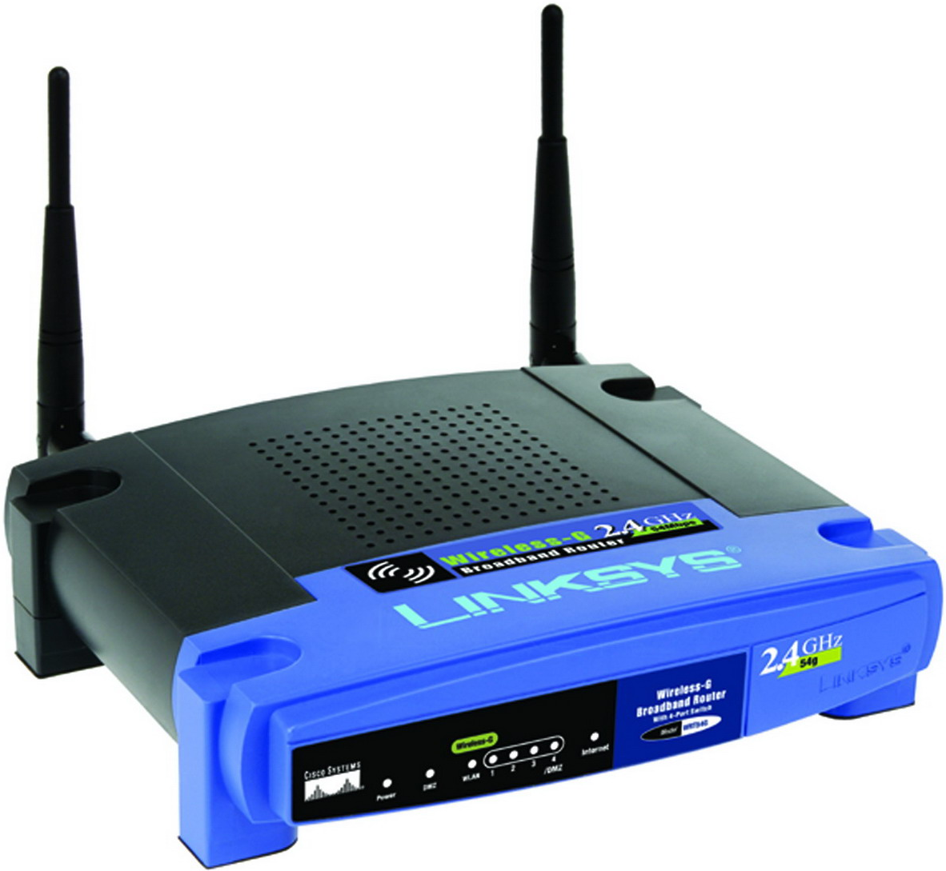
Solution: Concurrent PoWi-Fi transmissions
Power Packet #1
DIFS
Power Packet #2
Power Packets
t
Power Packet #3
Notes:
To do this we leverage the key insight that the since power packets do not contain any useful information, we can safely collide the power packets.
Let’s say at any instant the middle router wants to transmit data. IT precedes the transmission of power packet with a 1-byte long packet. This packet is decoded by all the neighboring PoWi-Fi routers and they all join the leader in transmitting a power packet within a DIFS period.
The resulting power packet transmissions all collide and the network sees a fixed impact independent of the number of transmitters.

Slide 20
Concurrent PoWi-Fi transmissions
TCP throughput of between two Wi-Fi devices in a network
TCP Throughput (Mbps)
# PoWi-Fi routers
Notes:
Let’s rerun the earlier experiment with this new scalable protocol.
We start with one transmitter and scaled up to 6 transmitters implementing the new scalable protocol and ran a TCP floor.

Slide 21
Concurrent PoWi-Fi transmissions
TCP throughput of between two Wi-Fi devices in a network
TCP Throughput (Mbps)
# PoWi-Fi routers
Our design scales with number of PoWi-Fi routers
Notes:
We can see that mean throughput is more or less unaffected by the number of transmitters.
This shows that the technique is scalable with number of PoWi-Fi routers

Slide 22
Opportunistic multi-channel transmissions: Imitate continuous transmissions without affecting Wi-Fi network
Duty cycle aware transmissions: Reduce channel occupancy due to power packet
Scalable power protocols: Allows to scale with multiple PoWi-Fi routers
Notes:
So I have talked about the three techniques which enabled us to build the PoWi-Fi system which can deliver low power to devices using existing Wi-Fi chipsets.
Now, let’s see how this system performs in real world network conditions.

Slide 23
Real world deployment in 6 homes
Replaced the users Wi-Fi router with a PoWi-Fi
PoWi-Fi router setup to delivery power and provide Internet connectivity for 2 days
Consistently observed cumulative channel occupancy greater than 80%
Users experienced no noticeable difference
Notes:
We deployed our system in six homes for a period of two days in Seattle.
We went into the house and replaced the home owners Wi-Fi router with the PoWiFi router. The router was setup in the same configuration as the user’s Wi-Fi router. PoWi-Fi also setup to do the opportunistic multi-channel transmissions that I described earlier.
We observed that the system was able to consistently achieve greater than 80% channel occupancy. Which means that even in real work scenarios we can successfully deliver power.
The home users did not experience any difference in their internet connectivity. More results on the home deployment study can be found in the paper.

Slide 24
Wi-Fi powered devices
Notes:
In the demo video I showed you a prototype with an E-ink display, accelerometer and a micro-controller

Slide 25
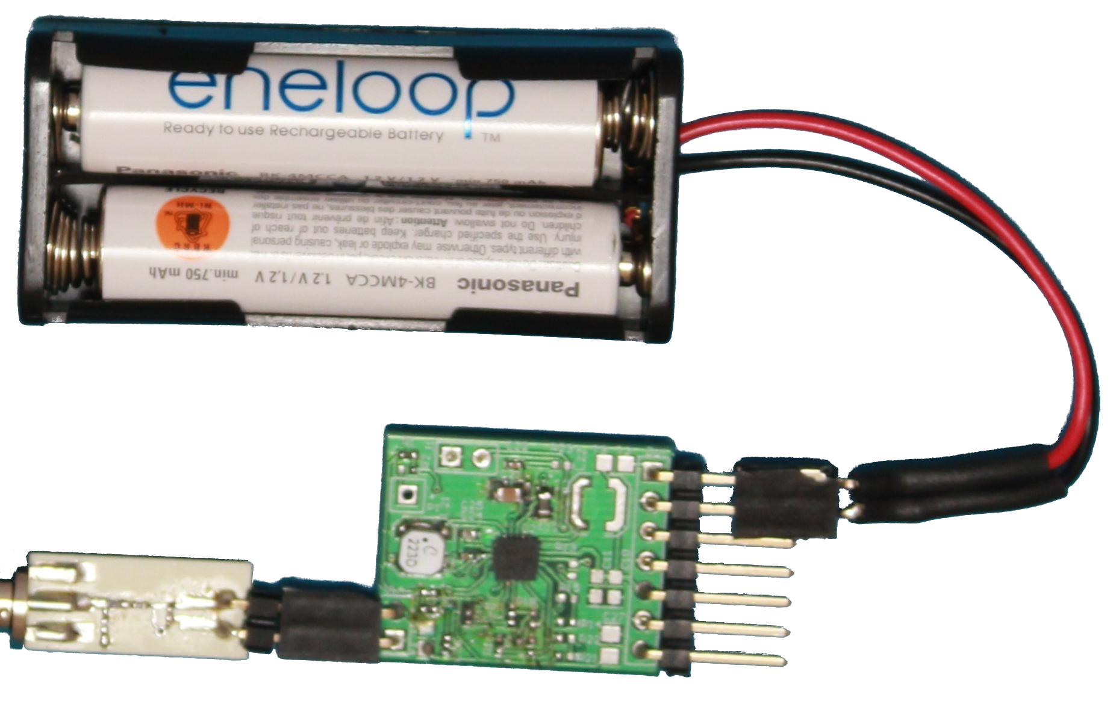
Wi-Fi powered sensors
Battery-free temperature sensor
Battery-free camera
Li-Ion battery charger
NiMH battery charger
Notes:
In addition to that, we also built a battery-free temperature sensor, battery-free camera and battery chargers for two of the most commonly used batteries.
To get a sense of kind of performance we can expect form a Wi-Fi powered devices, we placed the sensors at different distances from a router. The router was setup to continuously transmit using the opportunistic multi-frequency transmission that I described earlier. The router was transmitting at 4 W EIRP power, which is within the legal limits in the US

Slide 26
Wi-Fi powered temperature sensor
Sensor Reading/second
Distance (feet)
Notes:
Let’s start with the temperature sensor. In the graph on the x-axis we have distance and on the y axis we are plotting the number of temp. readings /second

Slide 27
Wi-Fi powered temperature sensor
Sensor Reading/second
Distance (feet)
Notes:
You can see that when we are close to the router we get about 30-40 reading a second and even at the max. operating range we get a reading every 4 second. This is sufficient for most applications.

Slide 28
Wi-Fi Powered Camera
Inter-frame time (minutes)
Distance (feet)
Notes:
Now in the case of a camera.
On the y-axis I am going to plot the time between successive frames.

Slide 29
Wi-Fi Powered Camera
Inter-frame time (minutes)
Distance (feet)
Notes:
And again you can see that the camera is very responsive when close to the router a few minutes between images and drops to about half an hour between images at the maximum operating range of 23 feet

Slide 30
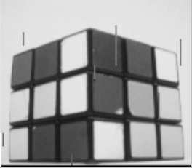
Applications of low rate cameras
Deploy in hard to reach places, e.g., attics
Integrate with ultra-low power motion detector to trigger camera
Notes:
Here is a greyscale VGA quality image of the Rubik cube taken by the camera.
You may wonder, where can I use this camera which gives me an image every few minutes or half an hour. (p)
Since it is Wi-Fi powered, this camera can work in non line of sight scenarios such as through walls and concrete. So you can imagine putting this camera in hard to reach places like walls and attics to detect pipe leaks and structural integrity. Once it’s embedded, it will function forever
Alternatively, we can pair this with a low power motion detector which can trigger the camera to capture an image whenever it detects a motion.

Slide 31
Wireless Charging Hotspot
USB charger for wearable devices
0 to 40% charge in 2.5 hours at a distance of 5 cm from a PoWi-Fi router
Notes:
Finally, we wanted to see if we can transform the Wi-Fi router into a wireless charging hotspot. We designed a USB charger which converts Wi-Fi signals into USB compliant DC power. We used this device to charge a wearable device such as the Jawbone UP24.
When the Jawbone was placed at a distance of 5 cm from the PoWi-Fi router, it went from a dead battery to 40% within two and half hours.
You can imagine that at night you can place your wearable device next your Wi-Fi router and every night the battery gets topped off and you never have to manually plug in the device. And the cool thing here is that since these devices have a 2.4 GHz antenna for Bluetooth, all the manufacturer needs to do is to add a tiny harvesting IC.

Slide 32
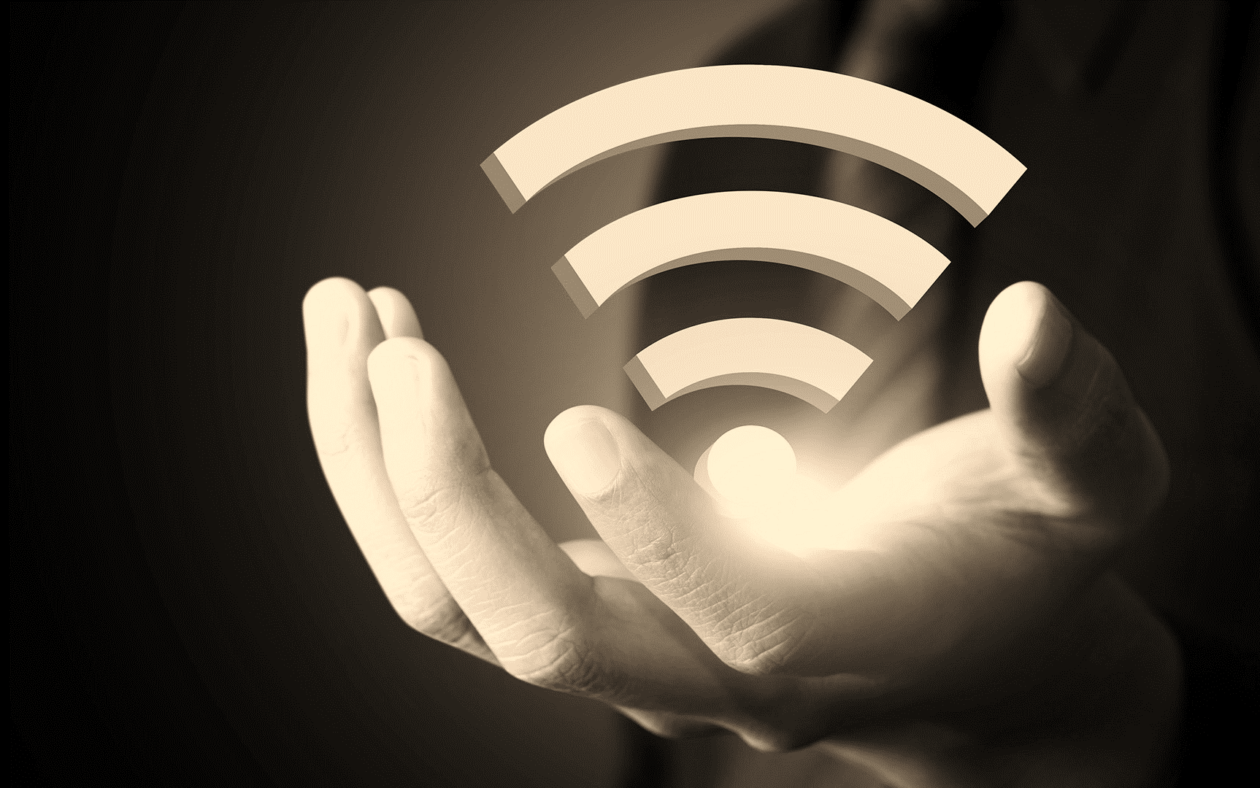
Conclusion
First system to deliver power to low-power devices using existing Wi-Fi chipsets
Real world deployment in six homes without significantly degrading network performance
Built the first Wi-Fi powered temperature sensor, camera, battery and USB charger
Notes:
To conclude, I have talked about power over Wi-Fi, the first system which can deliver power to low power sensors using existing Wi-Fi chipsets. (p)
We deployed the PoWi-Fi system in six homes and showed that it has negligible impact on the Wi-Fi performance
Finally, building on this we prototyped the the first camera, temperature sensors, battery and USB charger which are all powered from existing Wi-Fi chipsets.

Slide 33
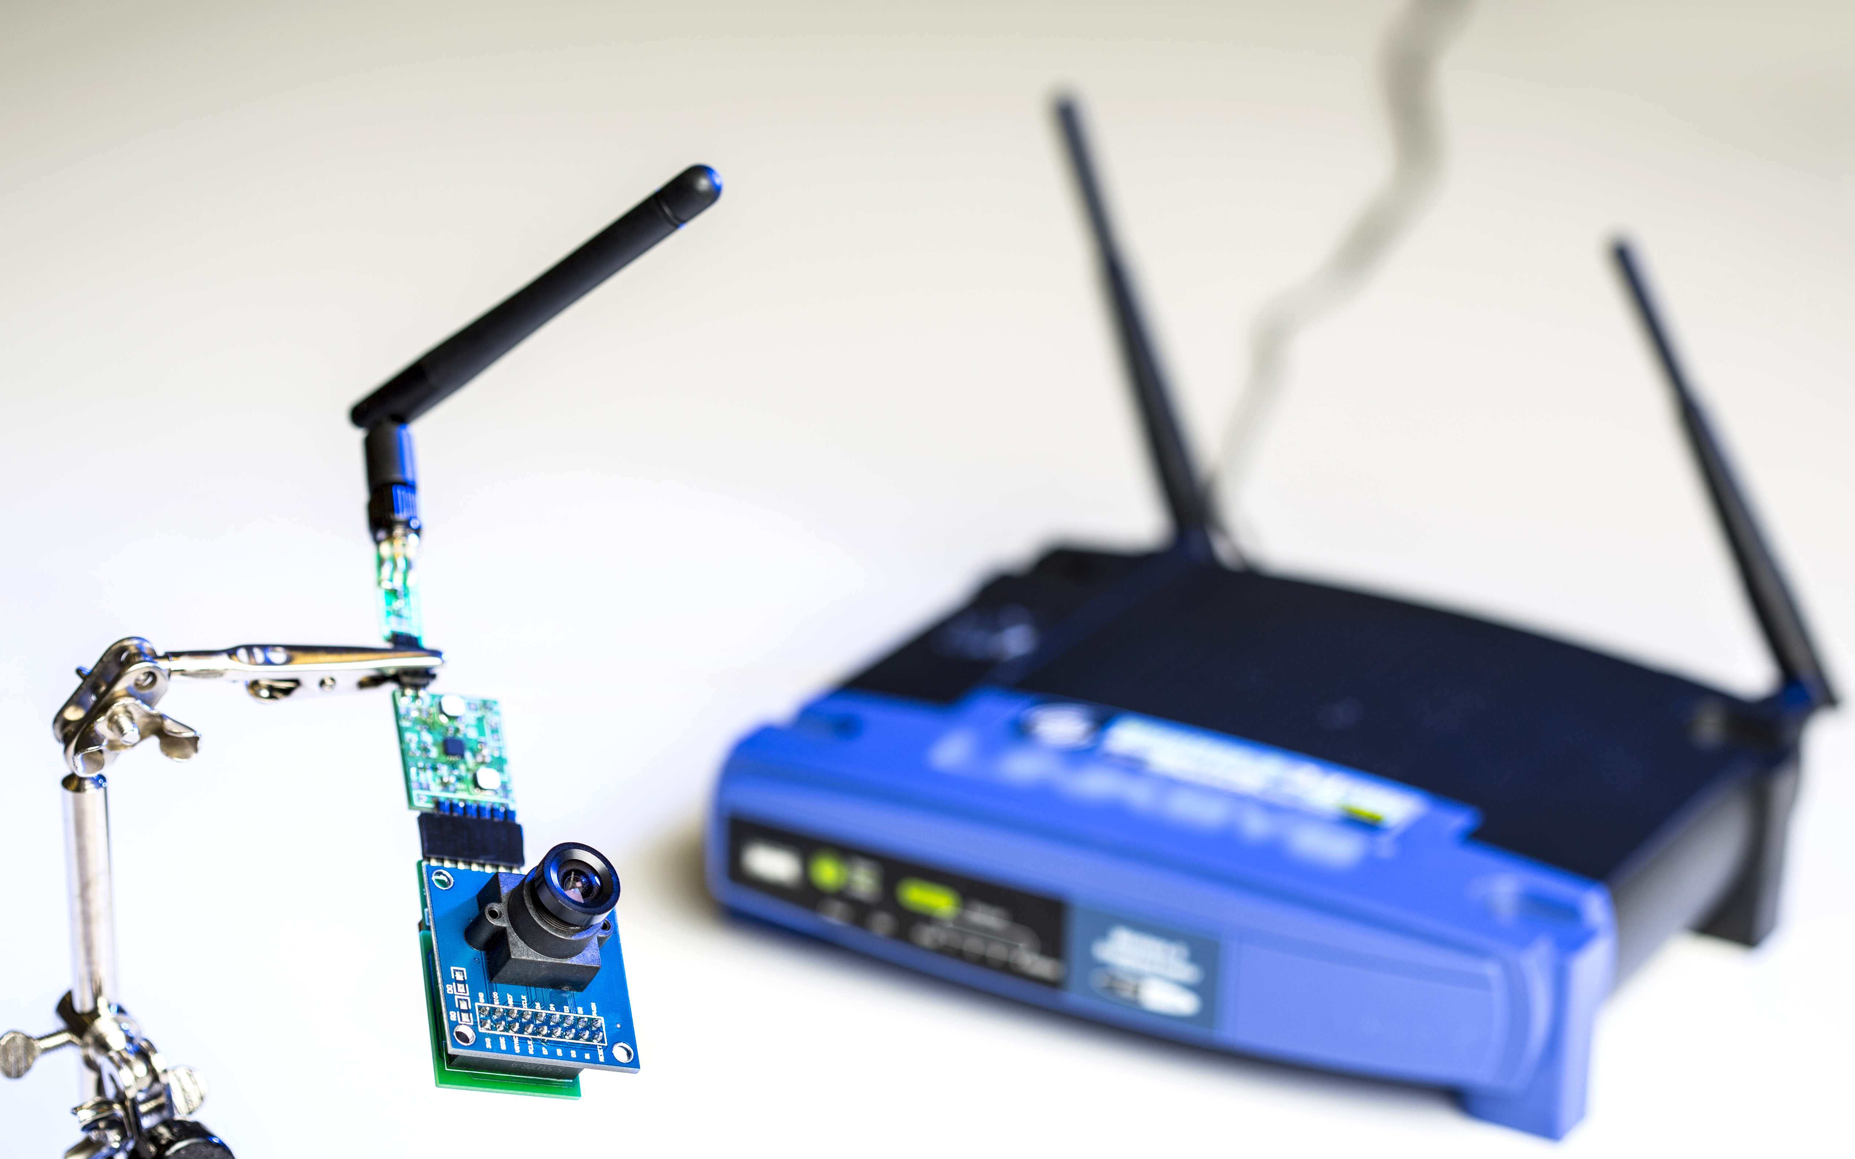
Thank you
Notes:
Thank you and I will be happy to answer questions

