Slide 1
Towards Internet Connectivity for Implanted Devices
Vikram Iyer, Vamsi Talla, Bryce Kellogg
Shyam Gollakota, Josh Smith

Slide 2
Brain implants for reanimation of limbs
Need wireless connectivity to make this practical and safe
Brown University - Guardian News & Media Ltd

Slide 3
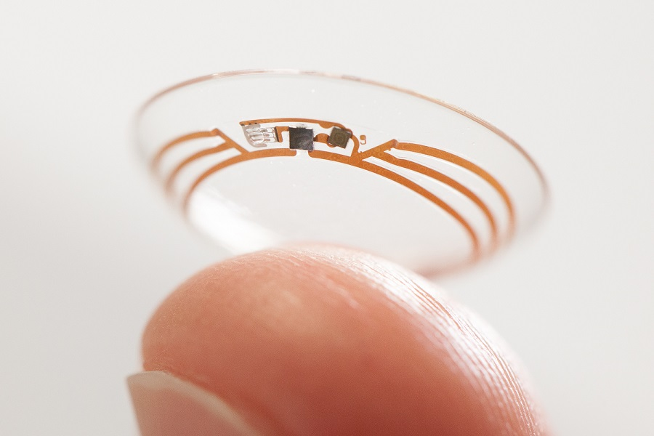
Contact lenses that measure blood sugar
Google- Business Computing World

Slide 4
Contact lenses that measure blood sugar

Slide 5
Can implanted devices talk to smartphones?

Slide 6
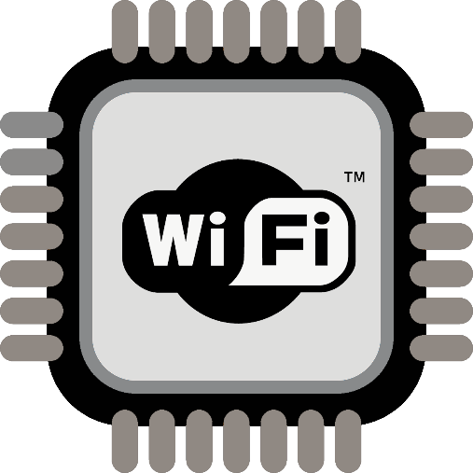
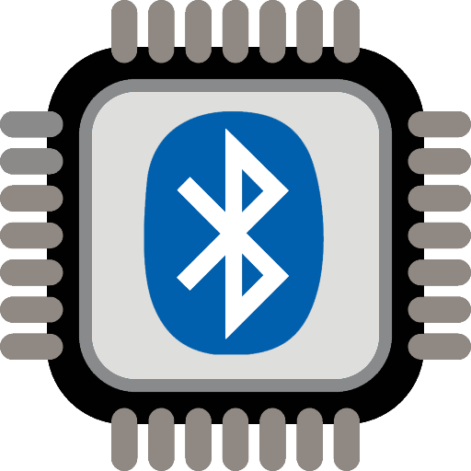
Conventional radios consume too much power
Replacing implant batteries requires surgery

Slide 7
Problem: Creating RF signals is power expensive
Solution: Recycle RF signals from external devices

Slide 8
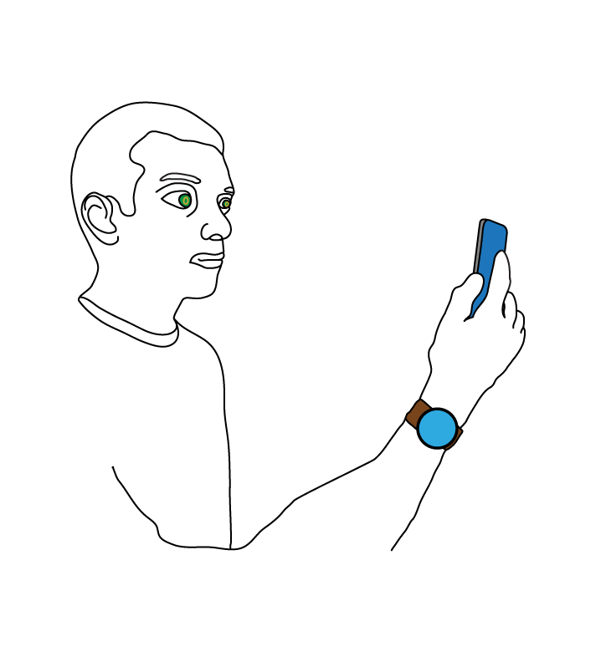
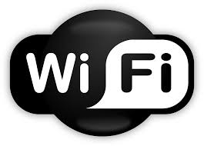
Interscatter Communication
Recycle Bluetooth signals to create WiFi
Creates WiFi packets for 28 μW of power

Slide 9
Our Contributions
Build first Wi-Fi contact lens and brain implant proof of concepts
Transform wireless transmissions from one technology to another, on the air
Bluetooth to 2-11Mbps Wi-Fi and ZigBee

Slide 10
System Requirements
Source
Receiver
Contact lens
Commodity devices → Bluetooth/Wi-Fi
Minimize implant ON time → Send data at high rate
Source isn’t sending data → Minimize bandwidth

Slide 11
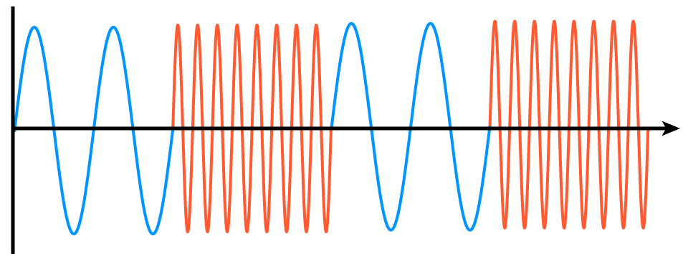
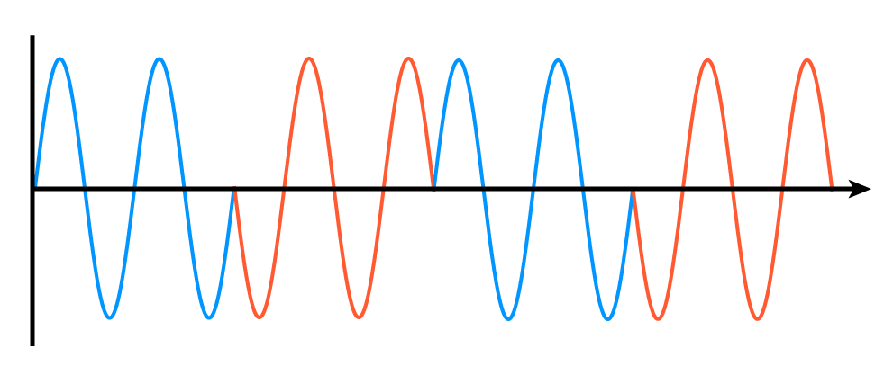
Problem: Bluetooth and WiFi are different protocols
Challenge 1: Different modulation
Frequency Shift Keying
Phase Shift Keying
Challenge 2: Different frequencies and bandwidth

Slide 12
Our Approach
Transform BLE transmissions into single tone signals
Step 2: Reflect the single tone signal to create our own Wi-Fi packets
Step 1: Transform Bluetooth transmissions into single tone signals

Slide 13
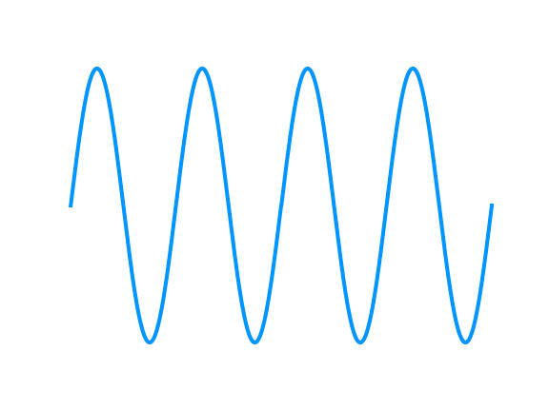
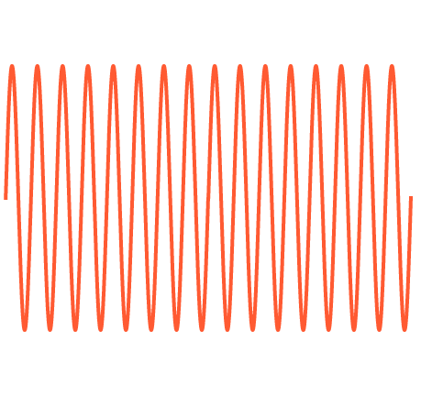
How do we create a single tone from Bluetooth?
Bluetooth uses frequency shift keying
flow = 0
fhigh = 1

Slide 14
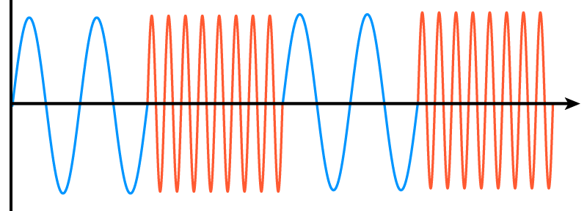
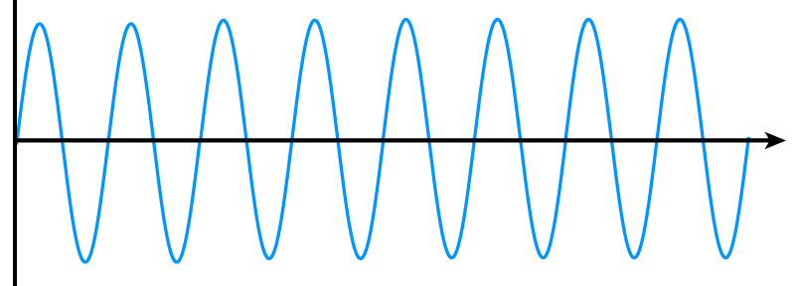
How do we create a single tone from Bluetooth?
Bluetooth uses frequency shift keying
0
0
1
0
0
1
Transmitting all ‘0’ or ‘1’ bits creates a single tone

Slide 15
How do we create a single tone from Bluetooth?
Problem: Bluetooth whitens the data
Original Payload:
11111
Pseudorandom bit generator
+
Whitened Payload:
11001
Seed
Seed is set to the channel number → Whitening sequence is constant

Slide 16
How do we create a single tone from Bluetooth?
Solution: Reverse engineer whitening sequence
Problem: Bluetooth whitens the data
Original Payload:
11111
Whitening sequence
Pseudorandom bit generator
+
Whitened Payload:
11001
Seed
00000
Seed is set to the channel number → Whitening sequence is constant
Transform Bluetooth to a single tone in user space

Slide 17
Our Approach
Transform BLE transmissions into single tone signals
Step 2: Reflect the single tone signal to create our own 802.11b packets
Step 1: Transform Bluetooth transmissions into single tone signals

Slide 18
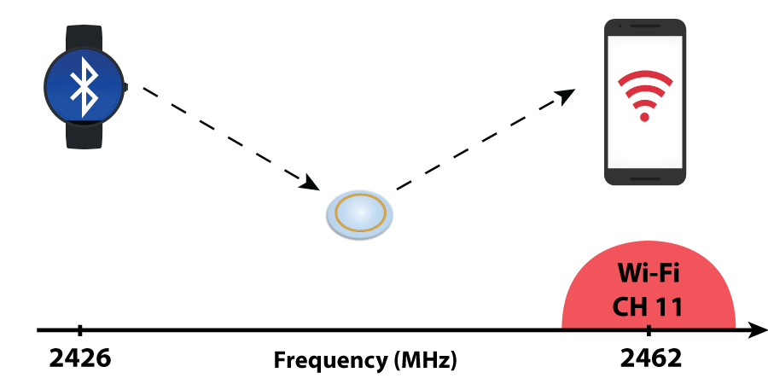
How do we create WiFi packets?
First-Order Solution: Use Passive WiFi (NSDI ‘16)
Problem: Bluetooth and WiFi use different frequencies
BLE 38
Smart contact lens

Slide 19
How do we create WiFi packets?
First-Order Solution: Use Passive WiFi (NSDI ‘16)
0 1 0

Slide 20
Problem: Passive WiFi creates mirror copy outside ISM band
Outside ISM
band
2.4 GHz ISM Band
BLE 38
Mirror Copy
Wi-Fi CH11

Slide 21
Solution: First single sideband backscatter
Key Idea: Cancel mirror copy using two switches
Mirror Copy
+
+

Slide 22
Implementation
FPGA Prototype:
Altera Cyclone II
Custom backscatter switch
2-11 Mbps WiFi and 250 kbps Zigbee
IC Implementation
Verilog baseband, RF switch, & custom PLL
TSMC 65nm LP Process
28 µW at 2 Mbps

Slide 23
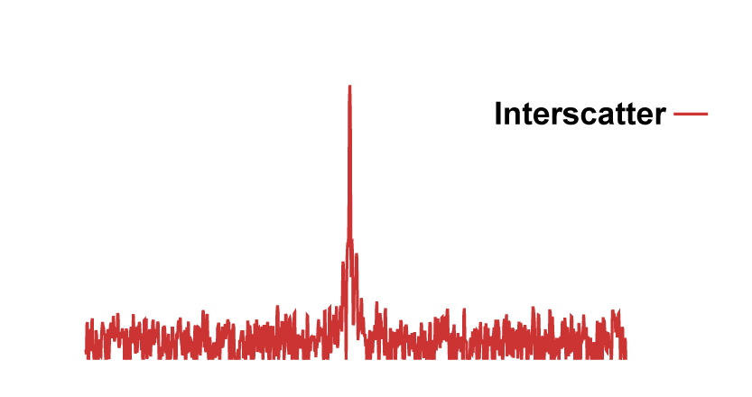
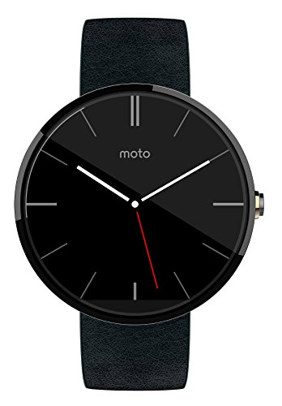
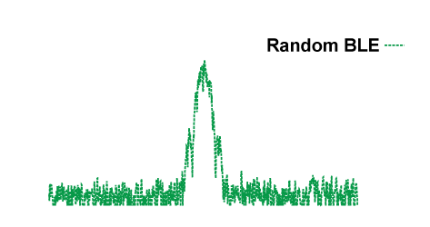
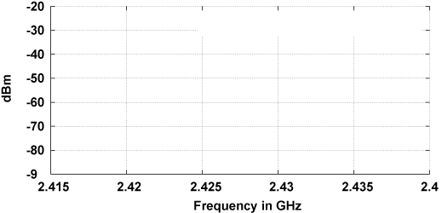
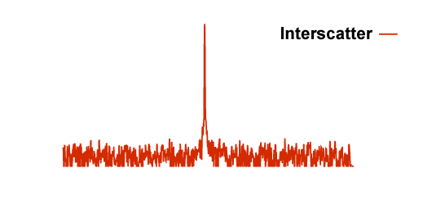
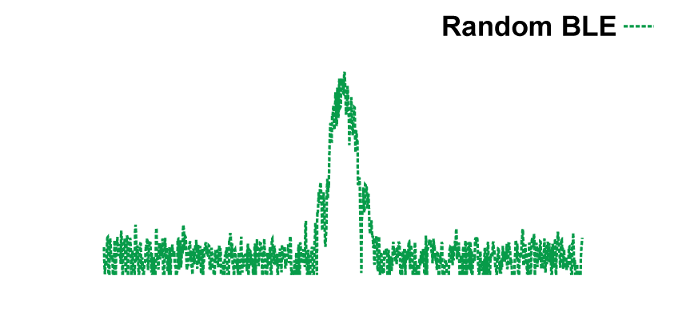
How well can we create a single tone from Bluetooth?
Moto 360 Transmission
Power (dBm)
-20
-40
-60
-80
2.415 2.42 2.425 2.43 2.435 2.44 Frequency (GHz)
Samsung Galaxy S5
Power (dBm)
-20
-40
-60
-80
2.415 2.42 2.425 2.43 2.435 2.44 Frequency (GHz)

Slide 24
What is the range of our system?
d1 = 1ft
d2

Slide 25
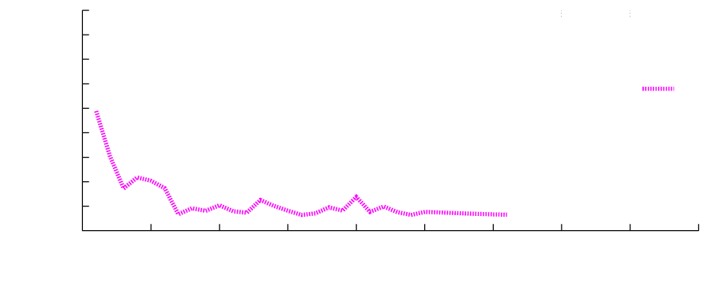
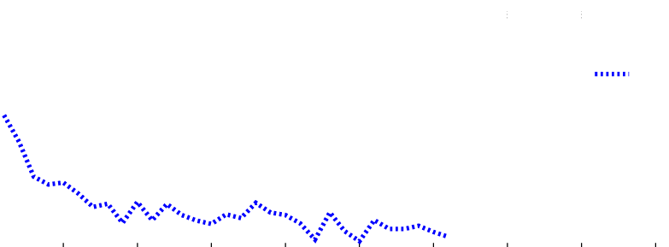
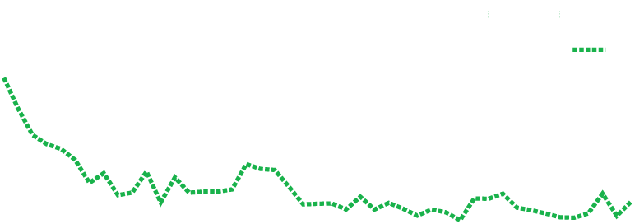
What is the range of our system?
-50
10 dBm
-60
4 dBm
Wi-Fi RSSI (dBm)
0 dBm
-70
-80
-90
0
10
20
30
40
50
60
70
80
90
Distance between backscatter device and Wi-Fi receiver (ft)

Slide 26
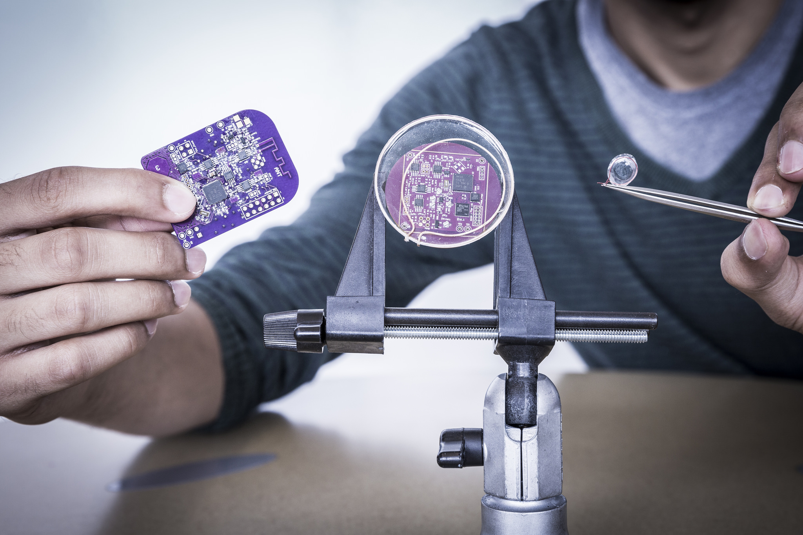
Proof of Concept Applications

Slide 27
Contact Lens Prototype
Bluetooth TX
Wi-Fi RX

Slide 28
BMI Prototype
Wi-Fi RX
Bluetooth TX

Slide 29
Conclusion
Transform wireless transmissions from one technology to another, on the air
Bluetooth to 2-11Mbps Wi-Fi and ZigBee
Opens up new opportunities for implanted devices

Slide 30
interscatter.cs.washington.edu

